Slide 1

Doordash Recommendations

Slide 2
Restructure data
Come up with new important metrics
Create dashboards to solve vital questions
Create dashboards to keep track of KPI
End

Slide 3
1st Goal: clean, restructure and deal with missing data / come up with important metrics that are not being tracked
Lets first clean and restructure the data set in a way we can import this data set to any program without any difficulty.
To be able to restructure the dates and change the type of field for each column. I will use python, tableau and excel.
My first recommendation would be to make sure that dates are stored in a recognizable format.
Since the complete date is missing, we will preset month=1 of year=1900
Now that the data is restructured let's focus on N/A(missing values).

Slide 4
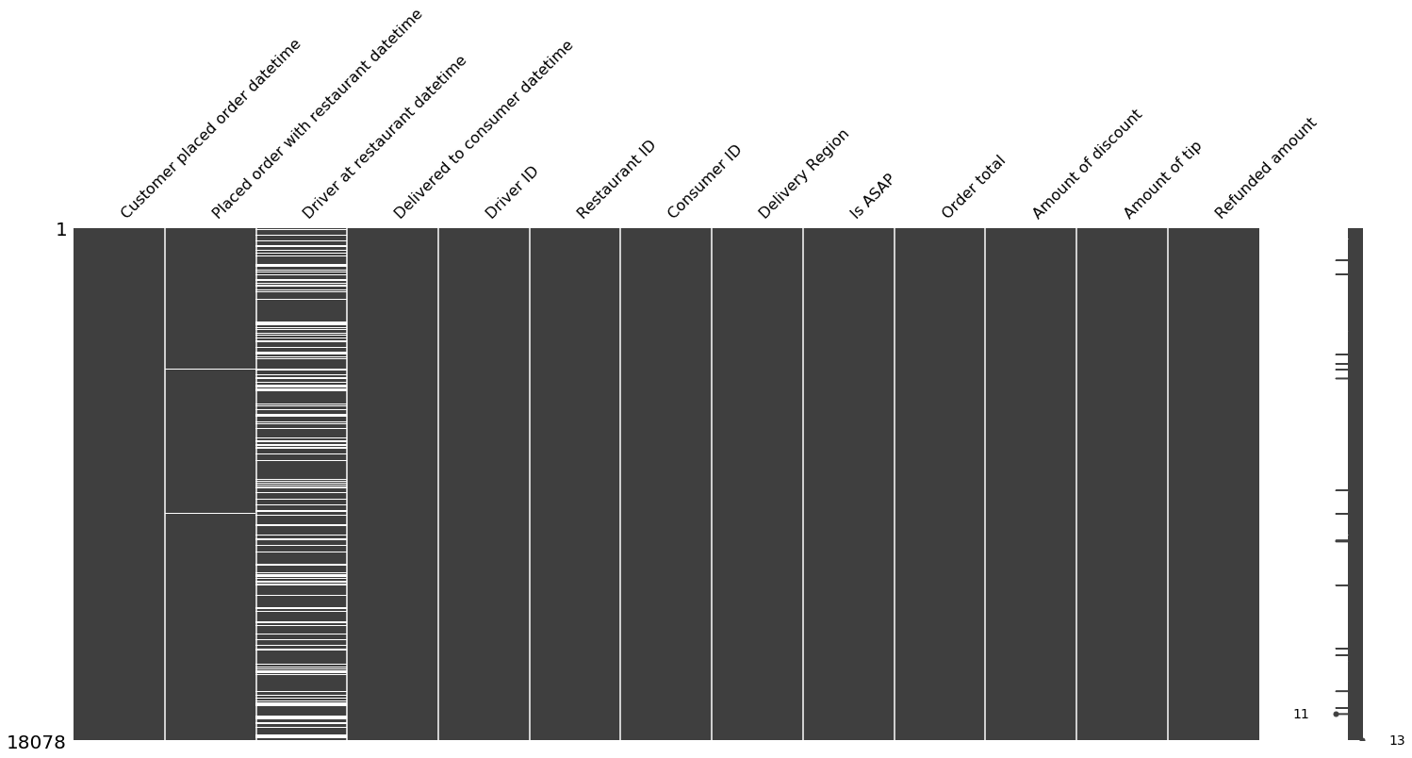
Missing values
We want to check which data field has missing values
This graph provides a better understanding on where the missing data is located.
The white lines in the column represent each null for that specific column. Most of the missing data is at the column “Driver at restaurant time datetime”

Slide 5
From the last graph we can identify that there are 2 columns with missing values.
“Placed order with restaurant datetime”: since the missing value count is very low there is not rush to fix this column
“Driver at restaurant datetime’: this field is missing a significant amount of data. Let's try to recognize why and how to fix it.
I don’t understand why Doordash is missing so much of this metric. I would assume that the driver needs to click manually that he has arrived. I would recommend that it automatically saves the arrival time. More important metrics could be tracked, for example: zip code, traffic in area, miles, etc.
“Driver at restaurant datetime” is a crucial field since without it we can't determine if our drivers are spending to much time waiting for the food.
Also, to be able to figure out the time spent waiting at the restaurant, Doordash would need to create a new column that keeps track of the time when the driver leaves the restaurant and when the food is ready, which I would also recommend keeping track off.
Since Doordash has not implemented this into the app we have to assume that it might never happen. So, we need to figure out a way to identify which drivers are not saving the arrival time.

Slide 6
Since Doordash has not implemented the automatic retrieval of the time when the driver gets to the restaurant, we want to find a way to find out which drivers or restaurants are causing this issue.

Slide 7
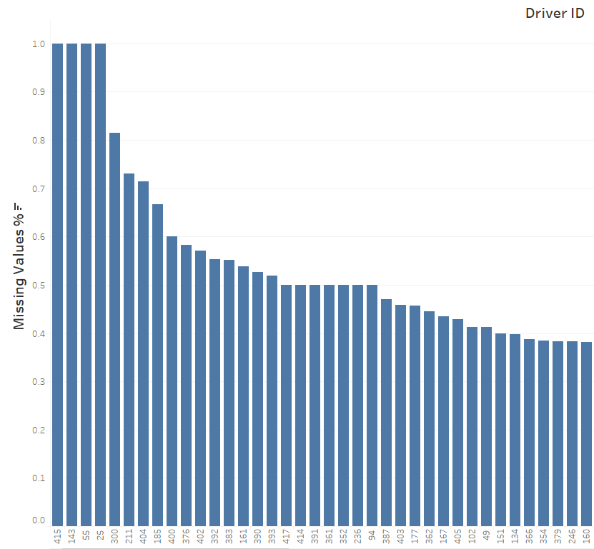
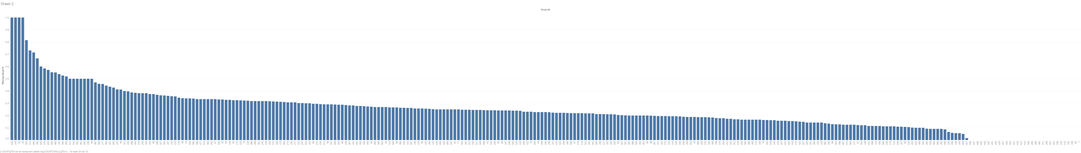
Let's start and check if there is a specific driver that does not save the arrival time:
Using the two graphs in this PPT we can see that there is a high increase of N/A rate after 0.5(50%)
Contact those drivers and request to mark their arrival time and ask why they haven’t been doing so.
Try to create incentives or an easier interface to encourage drivers to mark their arrival time.
Missing values% , Driver ID

Slide 8
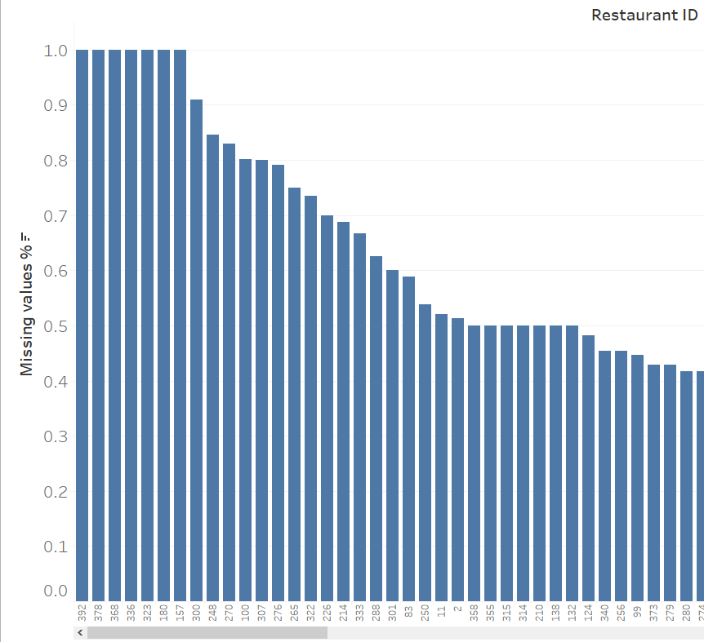
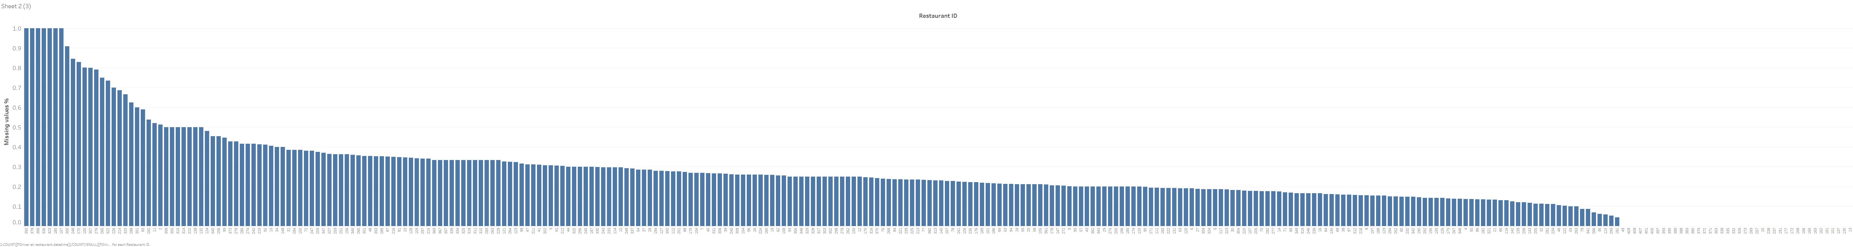
We will do the same procedure to get restaurants with high N/A ratio
We can now contact restaurant with the top % missing values and check what is happening.
Maybe drivers know that the restaurant in request takes longer to make the food and if they mark their arrival time Doordash expect the drivers to take at most X minutes picking up the food. However, for this specific restaurant the usual wait is around x+5 and these drivers might fear getting reprimanded for the restaurant fault.

Slide 9
Now that we know which drivers could be causing the missing values % Doordash should contact them. When contacting the drivers two scenarios two could happen:
The drivers didn’t realize this was a requirement and change their behavior
Best scenario
The drivers blame on location of the restaurant, waiting time, parking, walking distance as the reason why he or she does not want to save their arrival time.
For this situation I have created a dashboard that we can utilize to determine if is indeed something is going on with the restaurant or if the driver is providing us with false information
Let's see an example in the next PPT:

Slide 10
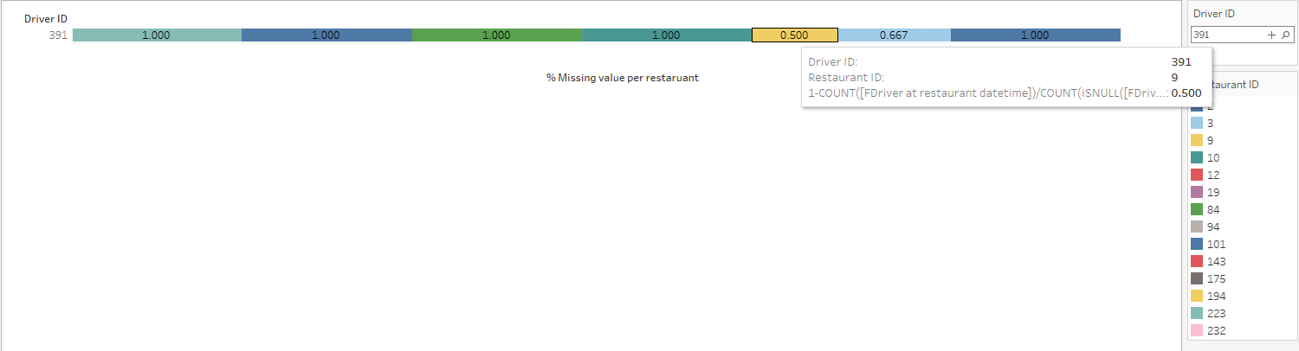
Example: Doordash calls driver 391since its N/A rate is 50%,according to the first graph discussed in ppt #7. Driver says he/she always saves his/her arrival rate but when he/she goes to the restaurant X he/she doesn’t. He/she claim that the parking is too far away from the restaurant or its always busy. So, if the driver did save the time, he/she would be afraid that the customer or Doordash might think it’s the driver's fault the food is taking longer than expected and lower their tip or something similar. To try to decide if the driver is being trithfull we can utilize the next visualization
As described in the plot we can see that in this example his excuse would be untruthful since he has 1 = 100% N/A rate for most of the restaurants he drives to.
With this information we can decide what could be done about this driver.
We can filter restaurants and drivers to customize this visualization to any type of combination.

Slide 11
I was going to cerate another dashboard just like the last one but for restaurants. However, for that graph to be useful Doordash would need to start retrieving the time when the food is ready "food ready metric datetime” and departure time of the restaurant. Which is why I would highlight that those metric should be recorded

Slide 12
Recommendation, part 1:
Recommendation:
Program the app so that it records the time the driver arrives to the shop automatically
Until this happens use dashboard to try to decrease missing values by identifying and contacting specific drivers and restaurants.
Create a new field that provides the times when the food is ready. Crucial field to determine if drivers are waiting to long for the food. Also, useful to determine if driver takes longer than usual to pick up the food once he arrives.
Other extra fields to keep track of zip code, traffic in area, miles, etc.
Now that we have solved the data structure and lack of information issue lets move on

Slide 13
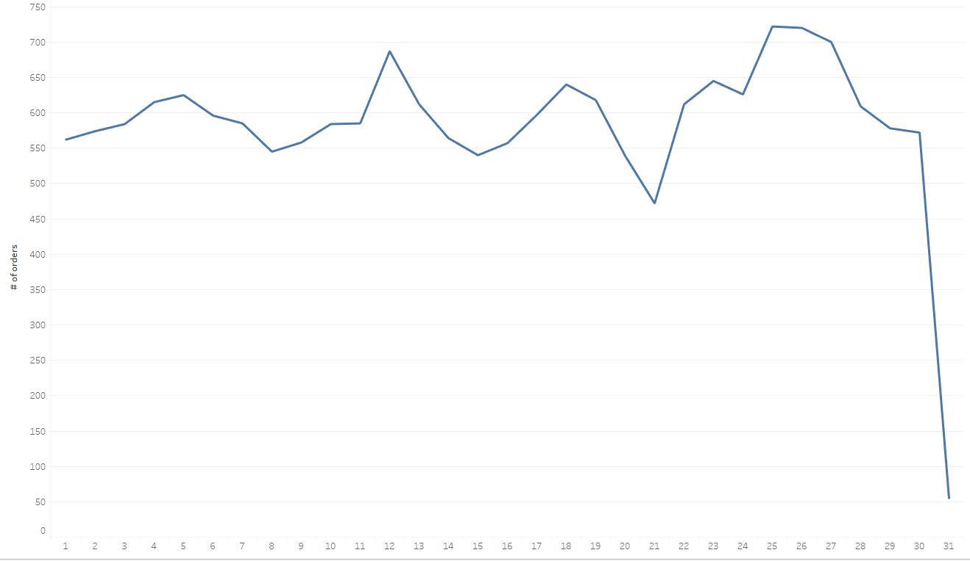
# of orders
2nd Goal: Recognize patterns in the data to schedule the correct amount of drivers for those times
Lets first try to find trends within our data.
Since we only have 1 month, we can't study how month affects the amount of orders, but we can do some research on how it fluctuates within the month
Assumption: day 31 is missing some information since it very unlikely to drop that suddenly

Slide 14
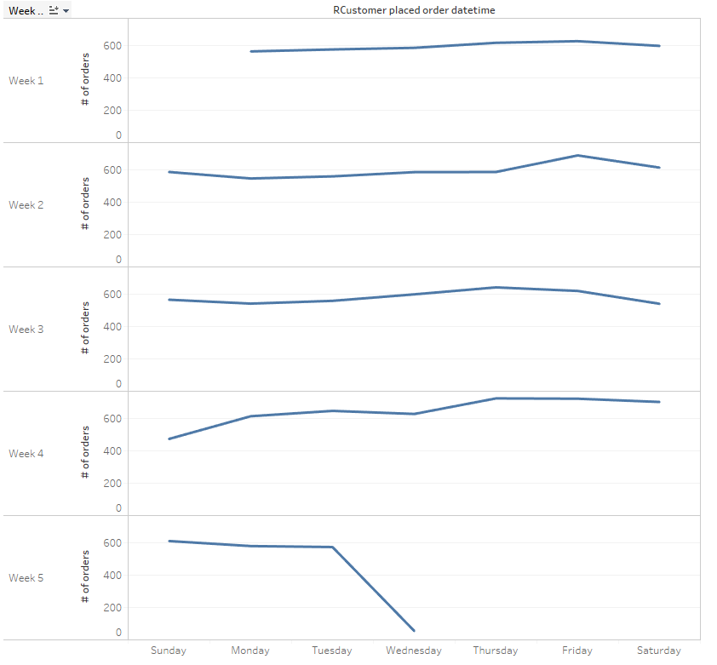
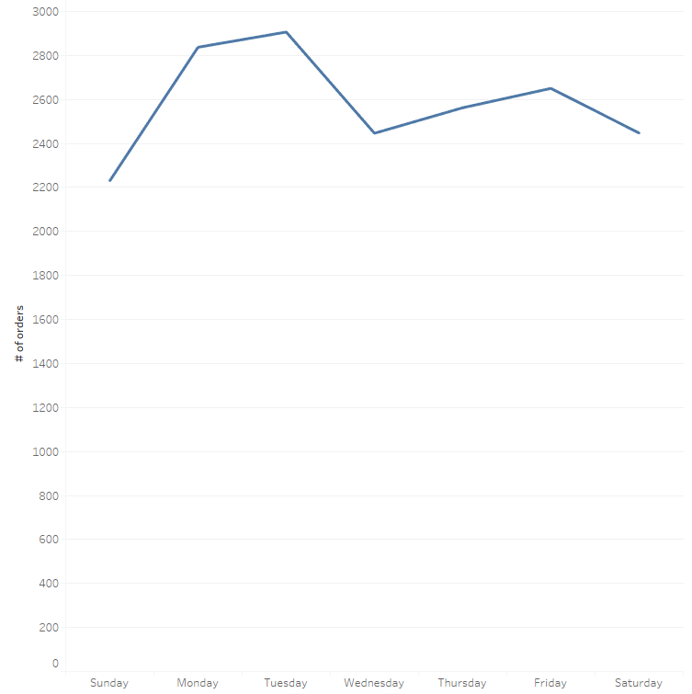
weekly/weekday/ trend
Aggregated sum of # of orders by week
Aggregated sum of # of orders by weekday
Next ppt for insights

Slide 15
By using the aggregated sum of # of orders by week and weekday we can say that:
Both graph shows a peek on the day of Friday with an amount of orders at 620-650. Followed by a slight constant decrease until Sunday/Monday that reaches 600-550.
After Monday it hovers around 600 and around Thursday starts increasing to repeat the cycle.
Week one compared to week 4 have not that much in difference. This can tells us the % of retained users has not changed
It would be good idea to create a metric that tells us newly acquire users and lost users, in that way we could keep track of the type of growth of the service.

Slide 16
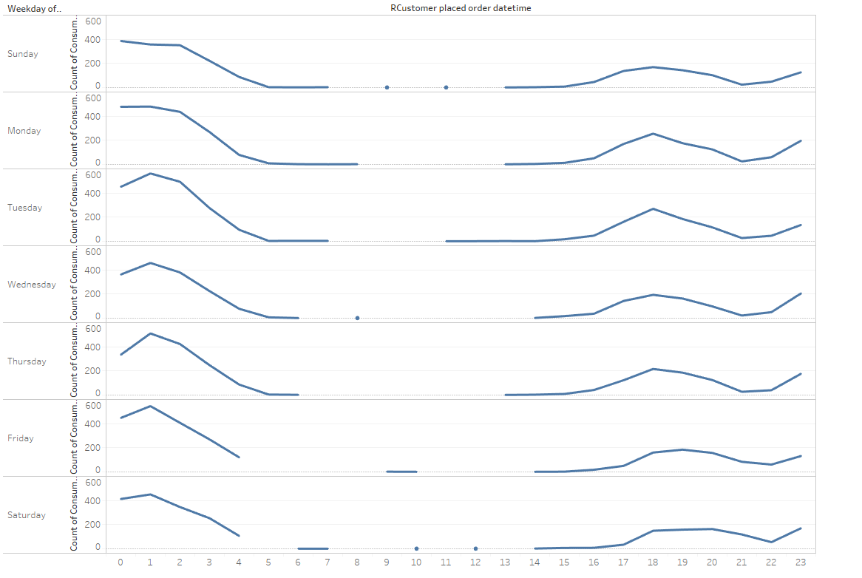
Hour trend
Most days have the same type of trend. Since the pattern is very repetitive, we can be certain of this. If uncertain there are some statistical tests to test if these come from the same distribution.
An increase in overall users mostly reflects on the busy hours, it doesn’t increase the demand in an even way. This would lead us to try to hire/encourage part time employees that focus one those hours since full time employees would not fit the business model. Although, some full-time night shifts might be a possibility.

Slide 17
Using the last two plots I would try to create a metric in the app that drivers can use to have an idea on how busy is going to be in a specific date and time.
The reason for this is that if there are too many drivers and not that many orders then drivers would try to find other ways to make money since Doordash wouldn’t be reliable. If this scenario was inverted, more orders than drivers, then some customers won't be able to find drivers to take their order and they would look for a different app. Both scenarios are harmful for Doordash that’s why a good balance would be ideal
This gold ratio would be when customers can always order, maybe have to pay extra or wait longer in peek hours but never too much to be discourage of using Doordash.
And what is that golden ratio?
To be able to determine that ratio further analysis need to be done since distance, traffic, #orders, zip code, location, and other dimensions should be analyzed in combination of #orders and #drivers

Slide 18
Security
I have seen some videos in the internet that there are some ways to trick the delivery app and try to scam the company. This could be done by drivers and customers.
This is a major issue. To deal with this matter I decided to create a visualization that represents the % of money refunded per driver over the total amount of $ delivered by driver
This metric will help us identify if an individual has found a bug in the app or a loophole in the regulations.
Also, I created another visualization per customer that represents the % of money refunded over the total amount of $ spent during the start of his account.

Slide 19
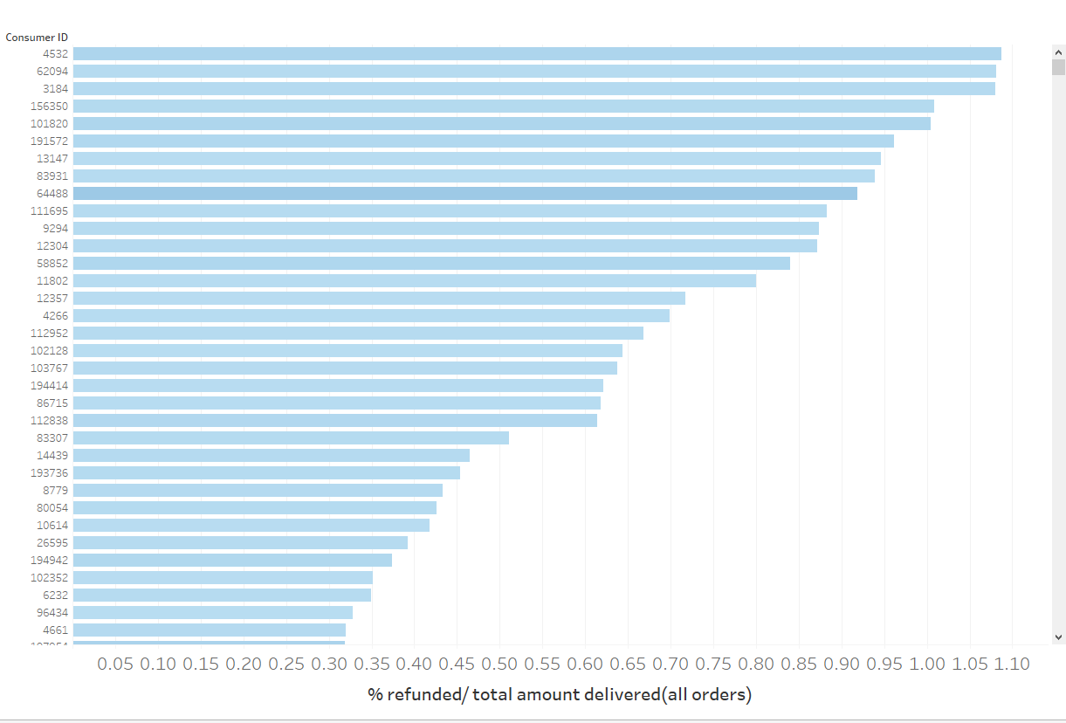

customers
If we see a dark blue color with a high %(a number close to 1 or higher) it means that that customer is a regular, and it is getting a high value of $ refunded. Therefore should create a note to further research that customer.
Example:In the graph on the right we can see that customer 4532 has a high return%(red flag) but since its color its light then he hasn’t ordered that much. So, if we do more research on the orders of that customer, we can see that:
He only ordered once and got a refund something might have happened, not a red flag, although the amount of the order is quite large so maybe dig a little deeper

Slide 20
A red flags would be a dark color with a high % of refunded $.Since nothing like that shows up in the last graph, we can stay calm for now.

Slide 21
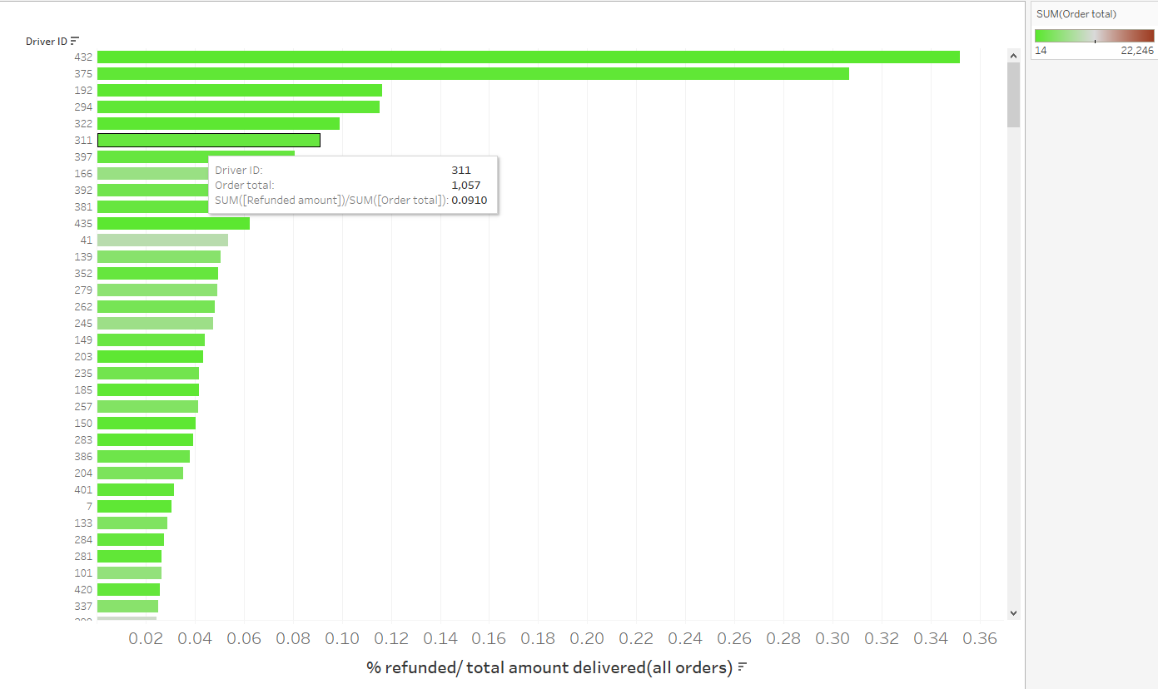
drivers
Same reasoning as the last visualization if we find a red value on top raise a red flag

Slide 22
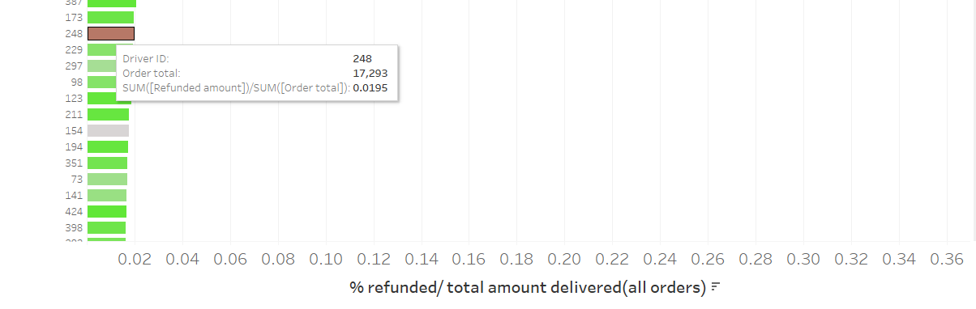
In this graphs we were able to find a red flag
Driver 248 has a total amount for that month of 17293 and has almost 2% refund rate which is not that high.
Since the amount of $ he has received is high it would be better to check what's going on

Slide 23
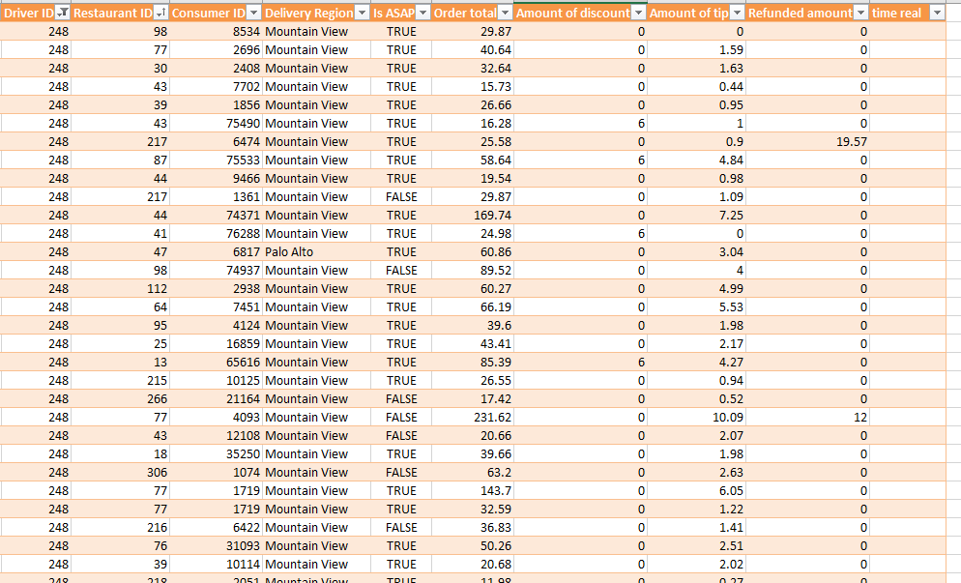
Nothing seems to suspicious.
I would have created a reusable dashboard to try to check if a driver is indeed doing something odd(lack of time). For this time I did it manually in excel and nothing seemed out of normal.

Slide 24
Recommendation, part 2:
Promote part time employees during high peek hours and if possible, contract full time night shift employees
Utilize the weekly, weekday, day and hour visualization to project and assess the amount of drives that will be needed in the future.
With more time and data try to create a forecasting algorithm to try to estimate the trend better.
Try to perfect the ratio of # orders to # of drivers so that everyone benefits out of it. More information and time needed to try to come up with this complex ratio.
Utilize customers and drivers plots to try to verify there is no hole in the regulations, policy or coding of the app.
If a user or customer seems to be getting high % refund start a more in-depth investigation

Slide 25
IN PROGRESS

